Slide 1
A Fusion of LSTM and GRU Neural Networks for
Predicting the S&P 500 Index
Final Presentation for the course Data Science
and Applied Machine Learning
Shijon Das

Slide 2
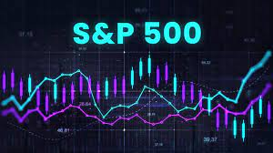
Introduction
Predicting future occurrences by analyzing historical data.
Widely applicable in business, economics, environmental sciences, and financial sectors.
Categories of Forecasting:
Short-term: Projections ranging a few seconds to months.
Medium-term: Extends to one or two years ahead.
Long-term: Encompasses predictions beyond two years.
Role of Deep Learning:
Deep neural networks are effective in approximating nonlinear functions.
Employ various architectures such as MLP, RNN, LSTM, GRU, and CNN.

Slide 3
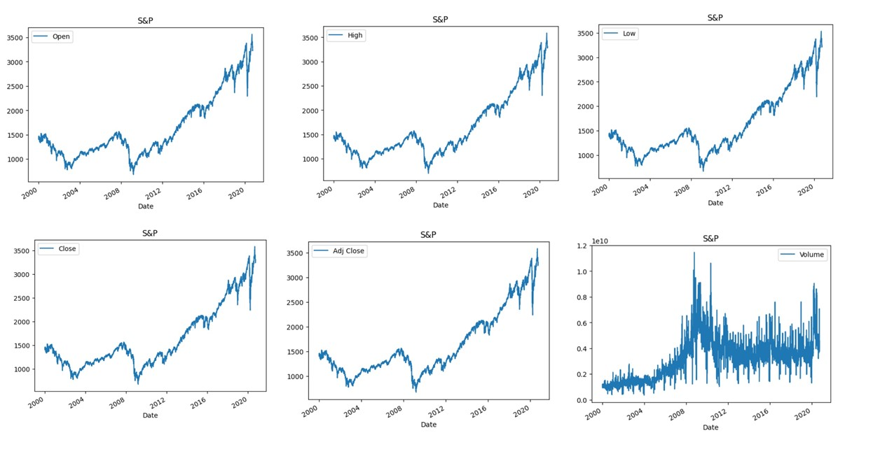
Dataset
Figure: Plot of every index with respect to date.
S&P 500 dataset contains stock prices from 2000 to around 2020
Dataset contains crucial market indicators such as Open, High, Low, Close, Adjusted Close prices, and trading Volume
Upward trajectory reflecting the long-term growth and resilience of the market despite periodic downturns
Major economic events such as the global financial crisis in 2008 and the COVID-19 pandemic around 2020 are evident in the data,
showcasing the market’s response to external shocks and subsequent recovery phase

Slide 4
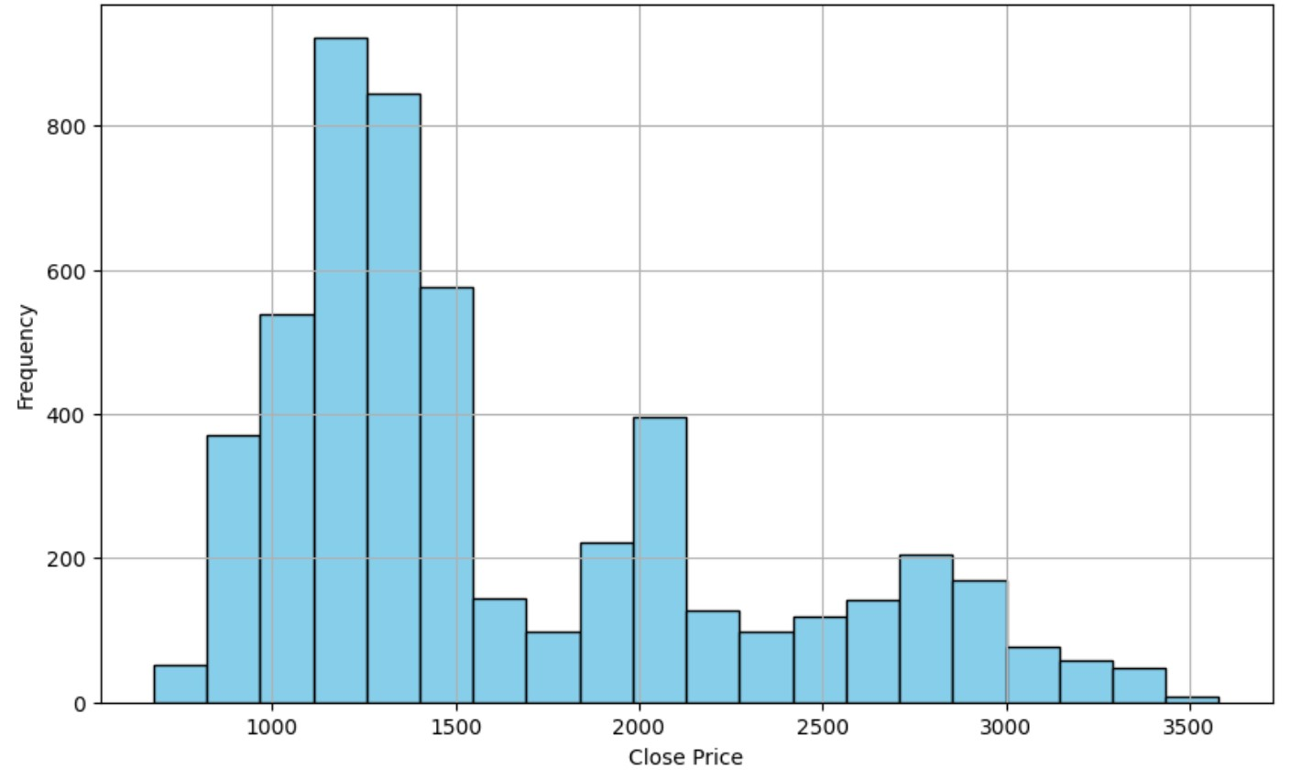
Dataset
Close prices are not normally distributed.
Most common close price range falls between roughly 1000 to 1500, as indicated by the tallest bar.
Noticeable gap in the frequency between price ranges of around 2000 to 2500, where there are significantly fewer occurrences
Shape of the histogram suggests that there may be multiple modes - local high points in the distribution of close prices
Imply that the asset has had periods of stability around certain price levels.
Figure: Histogram showing the distribution of Closing Price

Slide 5
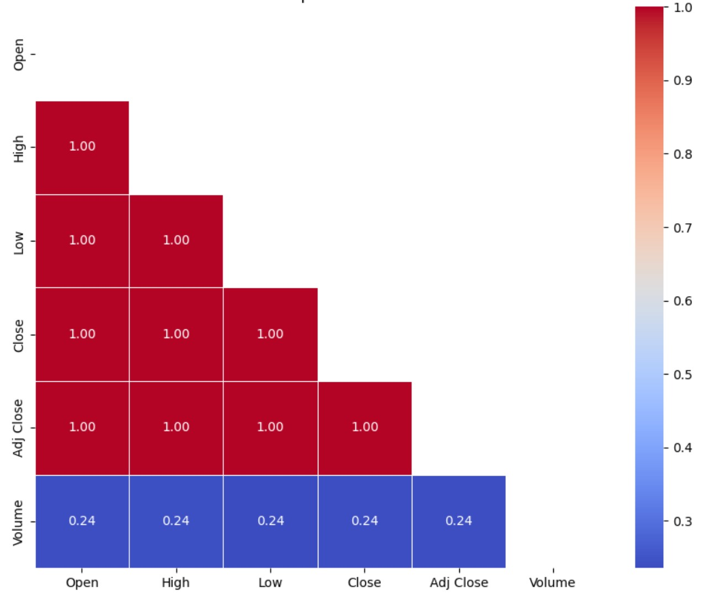
Data Preprocessing
Dataframe is converted into a time series format where each row is indexed by its corresponding date using set_index("Date")
"Open", "High", "Low", "Close", and "Adj Close" are all perfectly positively correlated with each other
Common when the variables are essentially representing the same underlying information, possibly with slight differences due to adjustments for dividends and stock splits
"Volume" has a low positive correlation with the other variables
Correlation with "Volume" is much lower, which could be expected as trading volume might not necessarily increase just because prices are higher or lower on a given day.
Used MinMaxScaler to normalise the features within a range 0 to 1
Normalisation ensures models learn more effectively and ensures that no single feature has too much influence on the final predictions
Figure: Correlation Heatmap

Slide 6
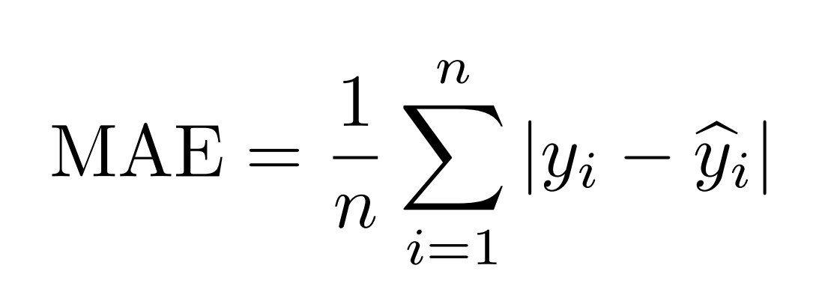
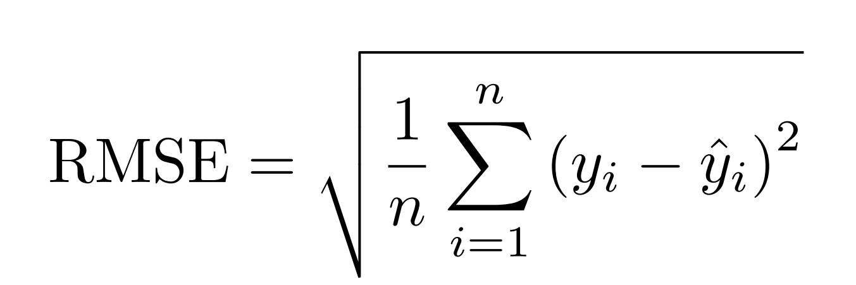
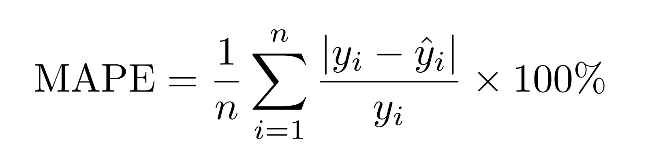
Implementations and Evaluations
This section talks about the architectures of the six models that we applied on our dataset
Used Google Colaboratory for executing all of our six models
For evaluating our six models we used Mean Absolute Error(MAE), Root Mean Squared Error(RMSE) and Mean Absolute Percentage Error(MAPE)

Slide 7
Model Specification
Table showing comparison of LSTM Model Architectures
Model | Layers | Regularization | Batch Normalisation | Optimizer | Callbacks
Model - 1 | 3 LSTM Layers | None | No | Adam | None
Model - 2 | 5 LSTM Layers | Dropout(0.2) | Yes | Adam | None
Model - 3 | 6 LSTM Layers | Dropout(0.2) | Yes | Adam | ReduceLROnPlateau, EarlyStopping
Model - 4 | 3 LSTM Layers | Dropout(0.2) | Yes | Adam | ReduceLROnPlateau, EarlyStopping
GRU model architecture excels at capturing sequential data patterns
3 GRU layers with same specifications and hyperparamters as Model -4 of the LSTM
GRU -LSTM model fusion is made to capture not just the short-term dependencies but also the long and complex temporal relationships inherent in financial time series data
Combined strength of LSTM and GRU, with their complementary capabilities, equips our model with a profound understanding of temporal dynamics, which is believed to enhance accuracy in stock market predictions

Slide 8
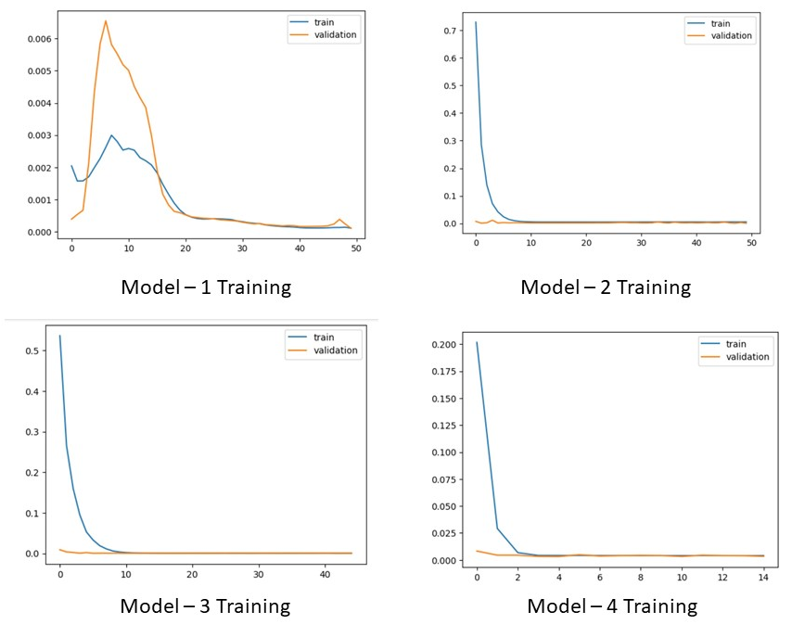
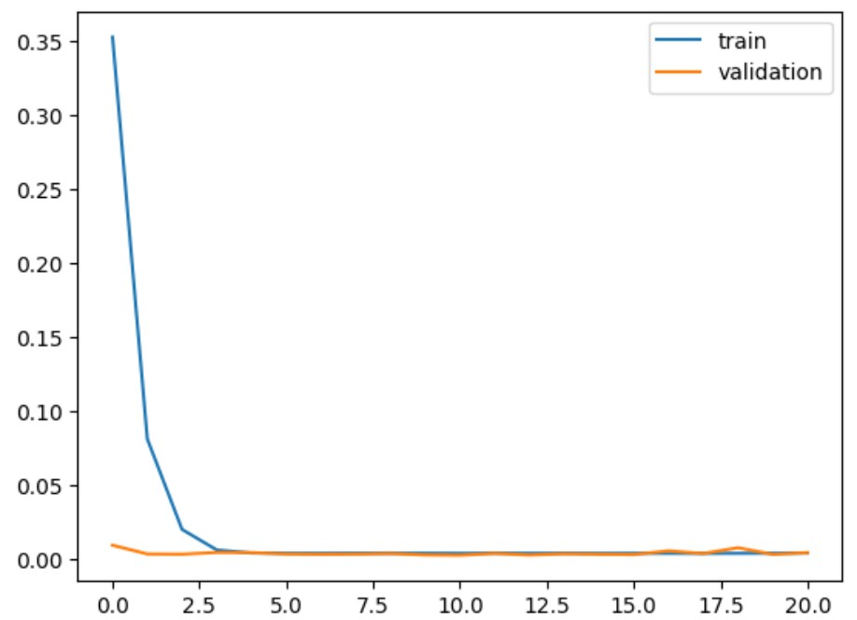
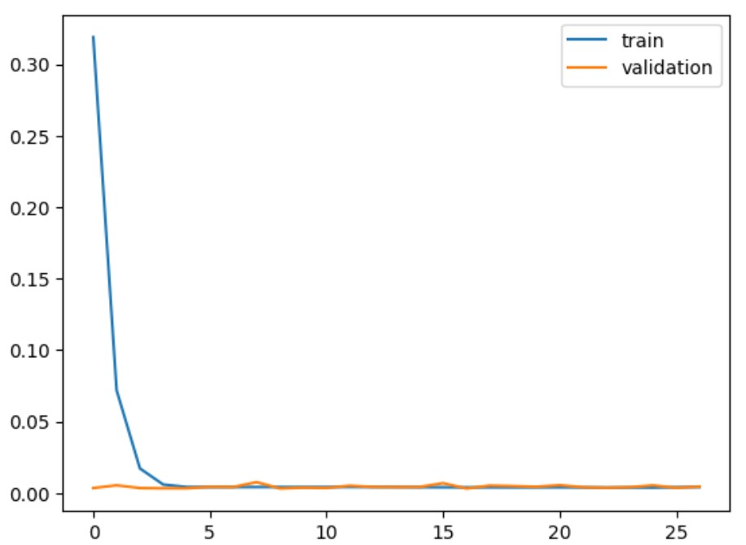
Model Training
GRU Training
Combined LSTM-GRU training

Slide 9
Performance Evaluation
Table showing Performance Metrics of LSTM Models
Model | RMSE | MAE | MAPE (%)
Model -1 | 0.379 | 0.362 | 274.47
Model -2 | 0.065 | 0.053 | 50.65
Model -3 | 0.130 | 0.117 | 99.90
Model -4 | 0.055 | 0.043 | 35.09

Slide 10
Performance Evaluation
Table showing Performance Metrics of Combined LSTM and GRU Model, Best LSTM Model, and GRU Model
Model | RMSE | MAE | MAPE (%)
Combined LSTM and GRU Model | 0.056 | 0.045 | 34.84
Best LSTM Model (Model 4) | 0.055 | 0.043 | 35.09
GRU Model | 0.060 | 0.049 | 34.60

Slide 11
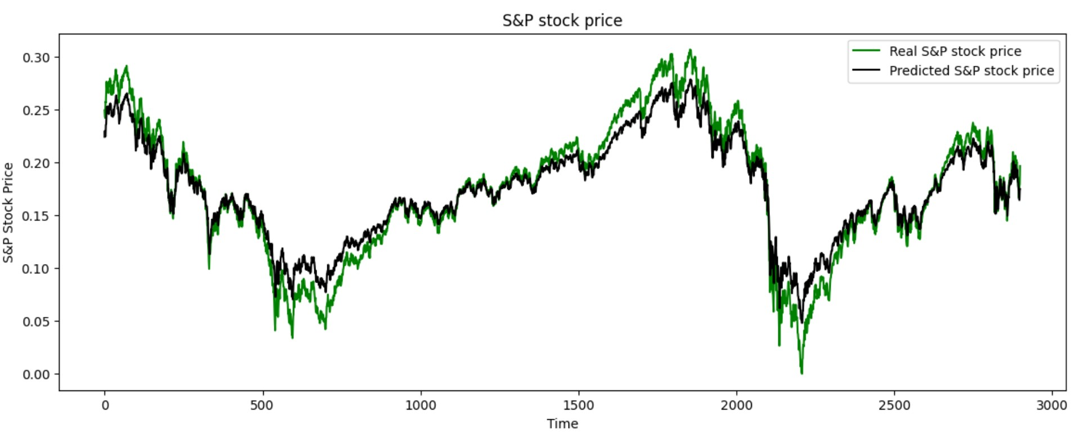
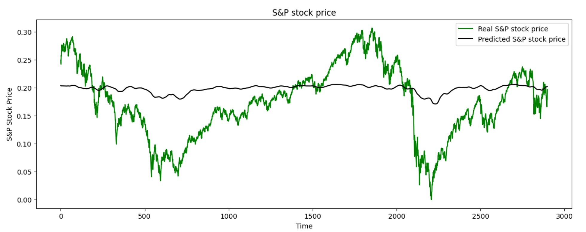
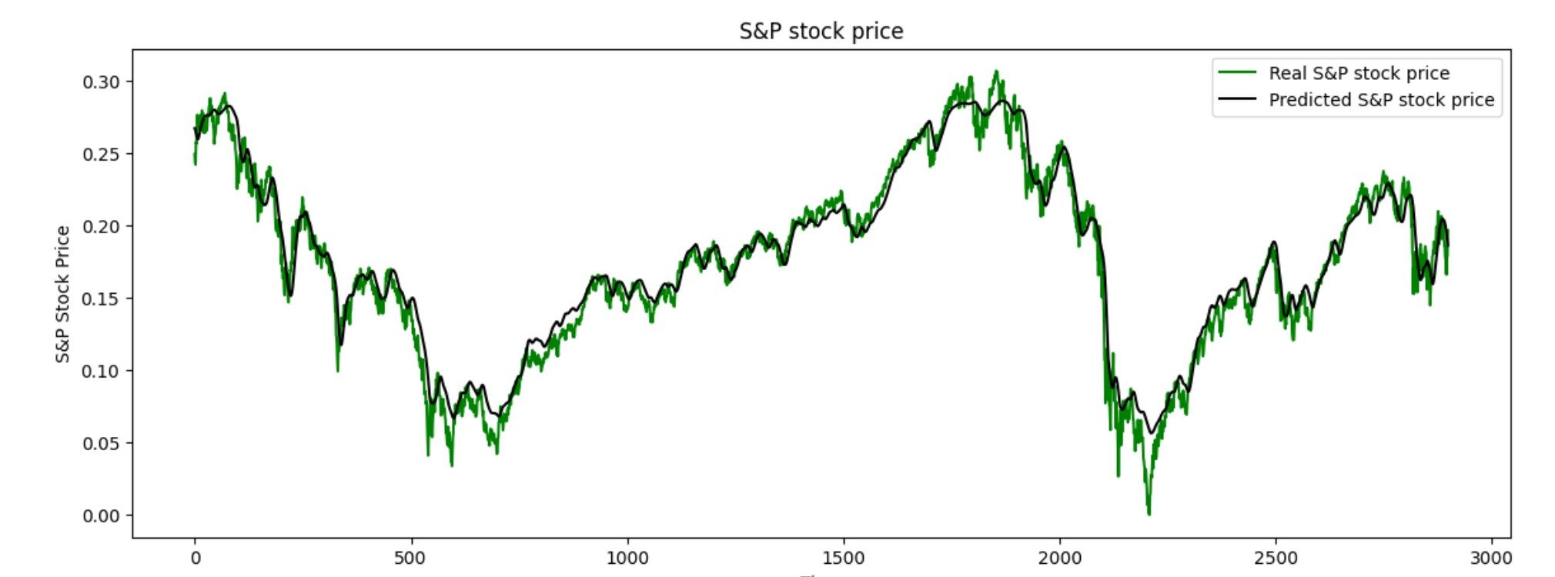
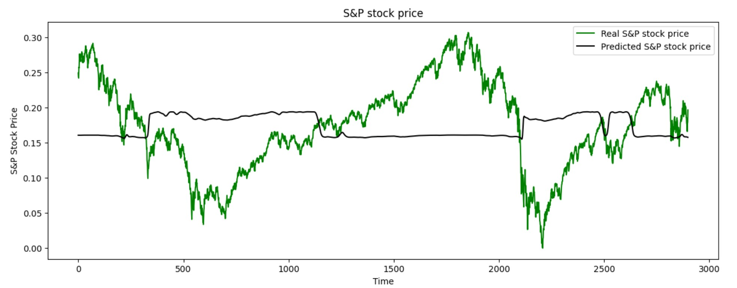
Comparison of Predicted and Actual Stock Prices
Graph for true and predicted stock price of Model -1
Graph for true and predicted stock price of Model - 2
Graph for true and predicted stock price of Model -3
Graph for true and predicted stock price of Model -4

Slide 12
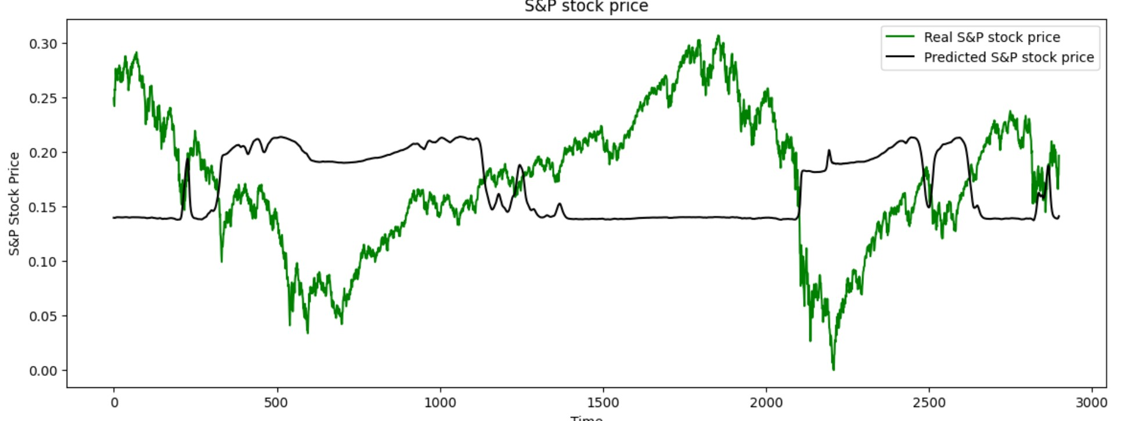
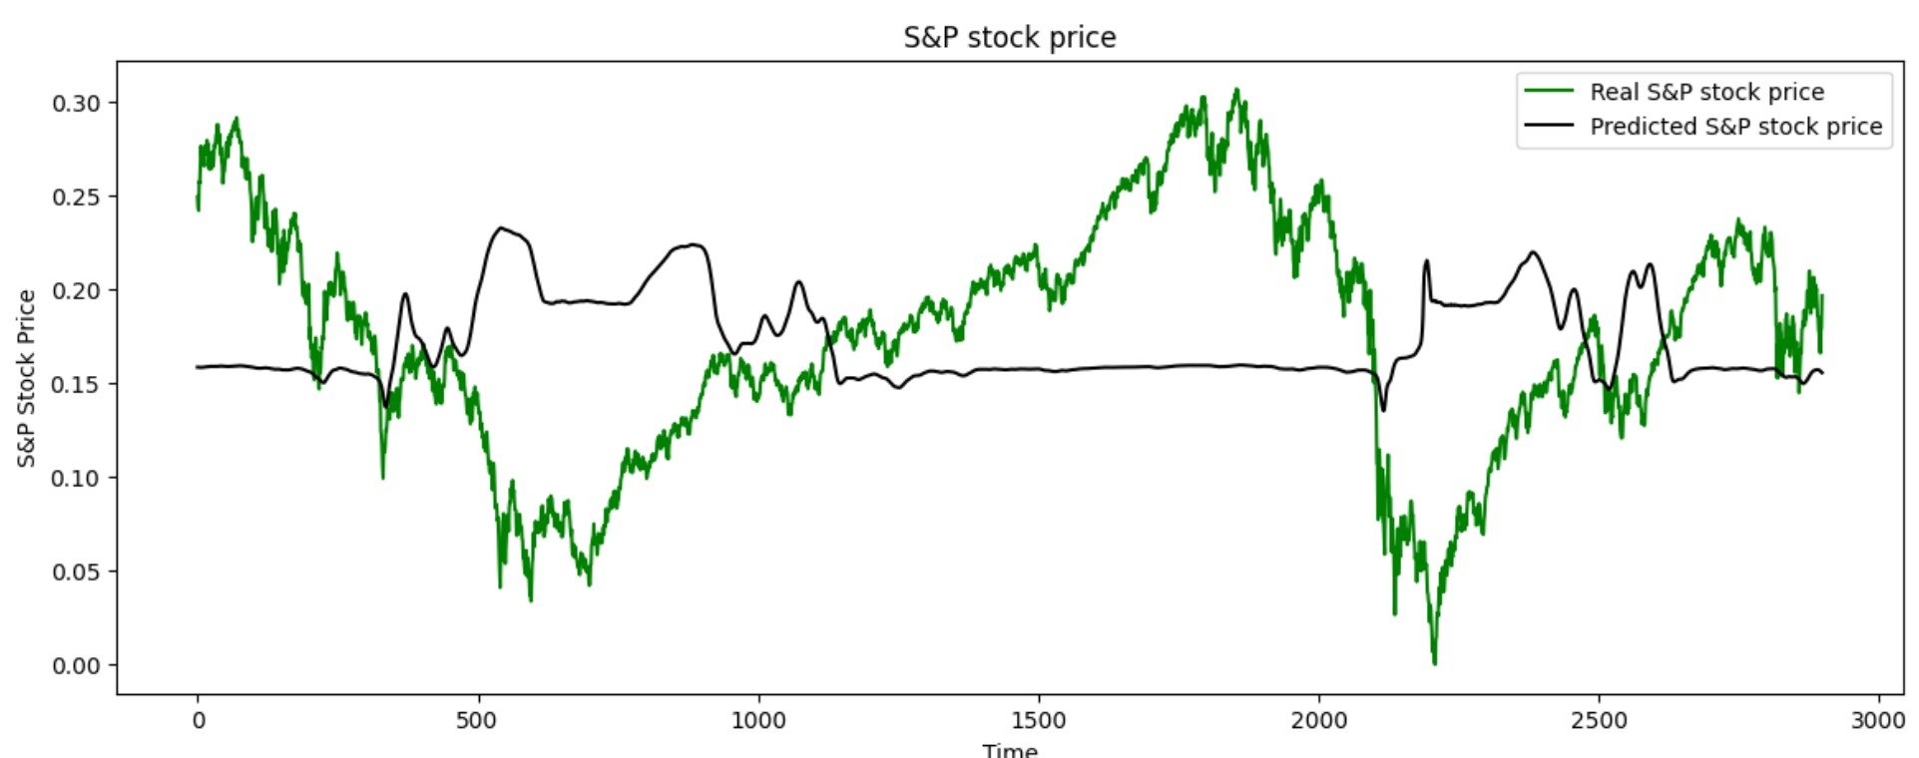
Comparison of Predicted and Actual Stock Prices
Graph for true and predicted stock price of GRU model
Graph for true and predicted stock price of combined LSTM-GRU

Slide 13
Comparison of Predicted and Actual Stock Prices
Graph for true and predicted stock price of GRU model
Graph for true and predicted stock price of combined LSTM-GRU

Slide 14
Conclusion
The superior performance of the combined LSTM and GRU architecture improves stock price predictions
LSTMs catch long-term patterns, while GRUs enhance efficiency and grasp intricate data relationships.

